Slide 1







Palo Alto Networks
Azure Active/Passive Guide
Matt McLimans, Public Cloud Consultant Engineer

Slide 2
SUPPORT POLICY
This is released under an as-is, best effort, support policy. These scripts should be seen as community supported and Palo Alto Networks will contribute our expertise as and when possible. We do not provide technical support or help in using or troubleshooting the components of the project through our normal support options such as Palo Alto Networks support teams, or ASC (Authorized Support Centers) partners and backline support options. The underlying product used (the VM-Series firewall) by the scripts or templates are still supported, but the support is only for the product functionality and not for help in deploying or using the template or script itself. Unless explicitly tagged, all projects or work posted in our GitHub repository (at https://github.com/PaloAltoNetworks) or sites other than our official Downloads page on https://support.paloaltonetworks.com are provided under the best effort policy.

Slide 3




DEPLOYMENT OVERVIEW
https-lb
This is a deployment guide 2xVM-Series firewalls in an Active/Passive pair.
This deployment aims to replicate the architecture in: Set up Active/Passive HA on Azure.
main-project
vpc=vpc-untrust
subnet=untrust=192.168.1.0/24
192.168.1.2/24
e1/1
e1/1
192.168.1.3/24
192.168.2.2/24
e1/2
e1/2
192.168.2.3/24
web-lb
10.10.1.100
vpc=vpc-trust
subnet=trust=192.168.2.0/24
Inbound Flow
Peering
Peering
10.10.1.100
10.10.2.2
10.10.1.2
10.10.1.3
spoke2-project
spoke1-project

Slide 4
STEP 1. LAUNCH TEMPLATE
Launch the ARM Template
https://github.com/wwce/azure-arm/tree/master/Azure-CommonDeployments/v1/2fw_3nic_avset_active_passive
Download active-fw-config.xml & passive-fw-config.xml. The firewall configurations are configured to reflect the default parameter settings.

Slide 5
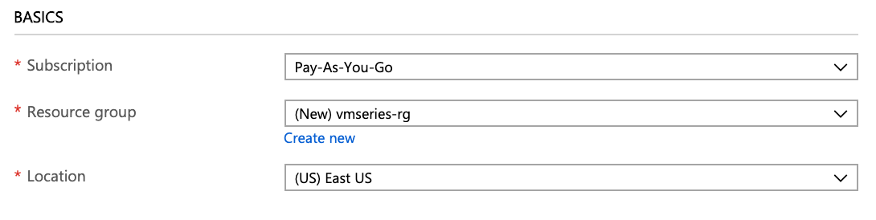
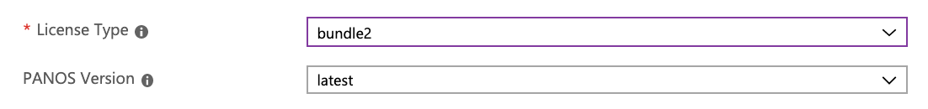
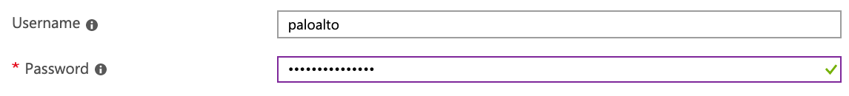
STEP 2. USER REQUIRED PARAMETERS
Resource Group: Create a new Resource Group
All resources deployed in template will belong to
Resource Group selected.
License Type: Select BYOL / Bundle1 / Bundle2
Username: Enter username (do not use admin or root)
Password: Enter password.

Slide 6
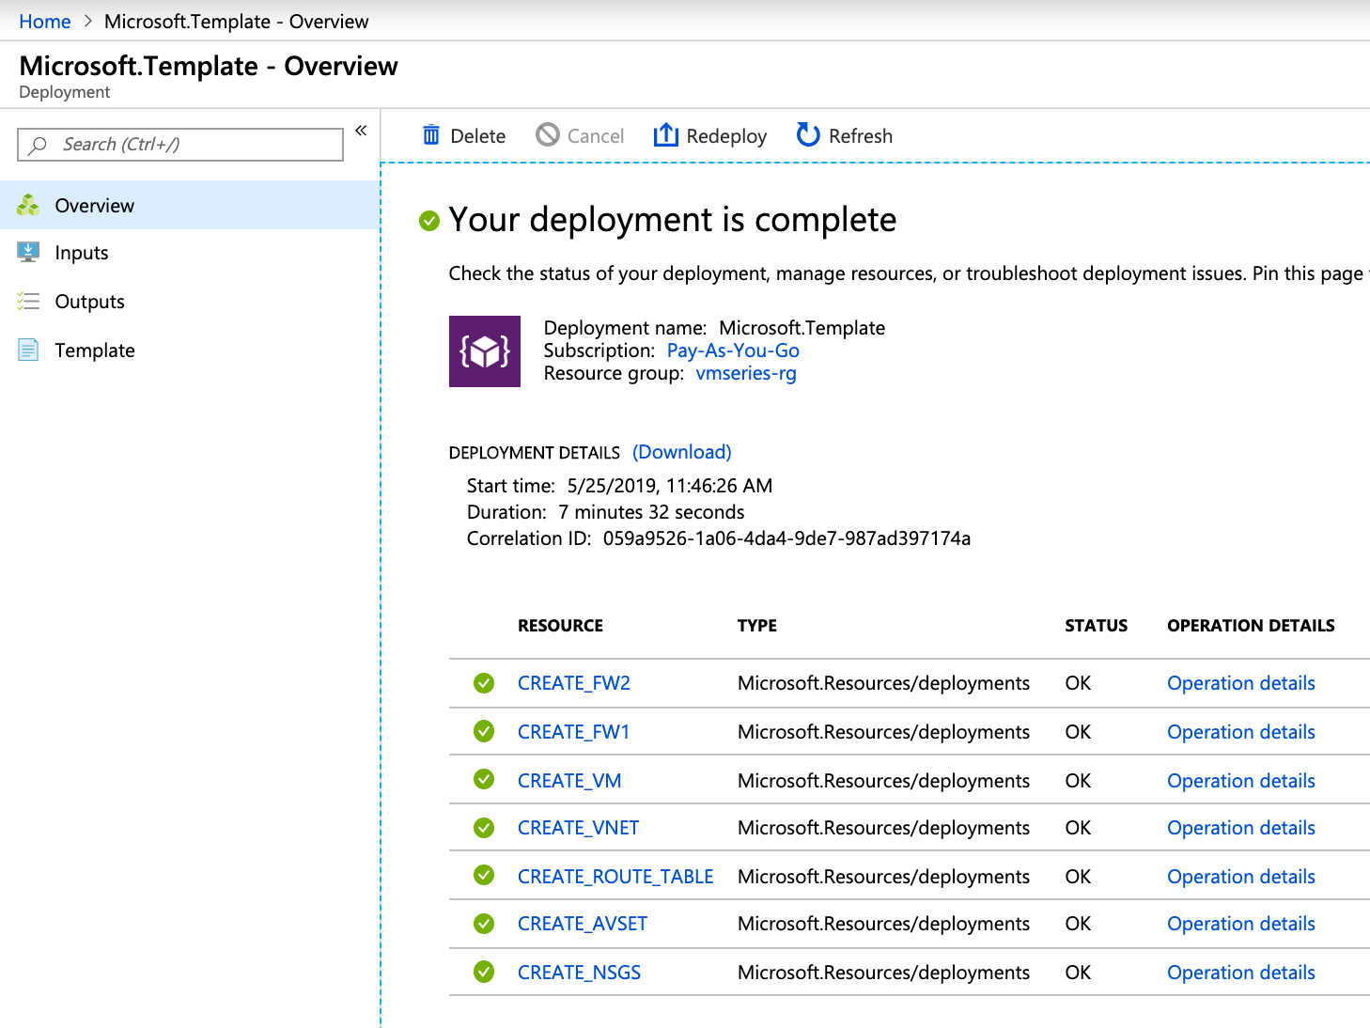
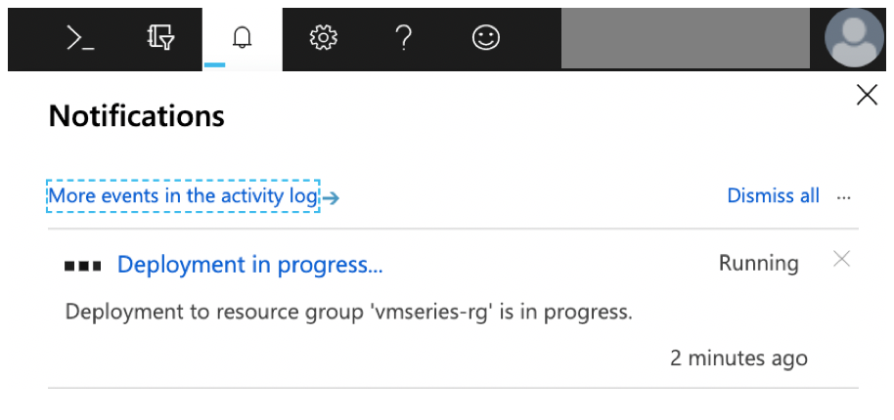
STEP 3. VERIFY DEPLOYMENT & OPEN RESOURCE GROUP
Once the deployment completes, open the Resource Group.

Slide 7
CONFIGURE
ACTIVE FIREWALL

Slide 8
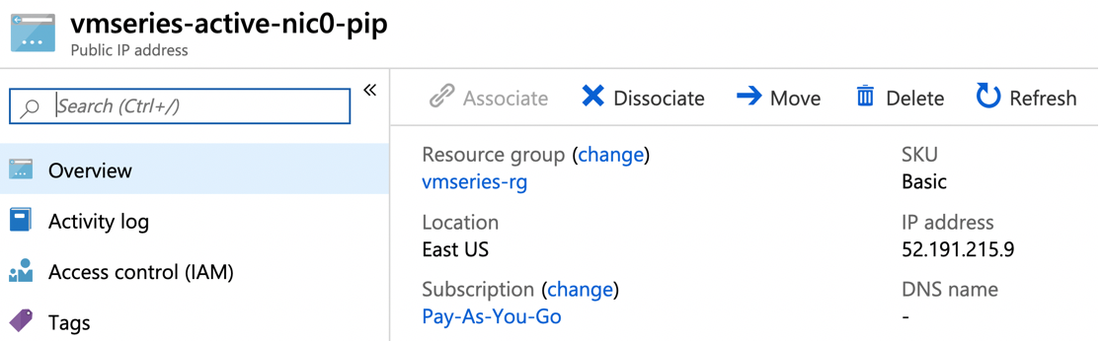
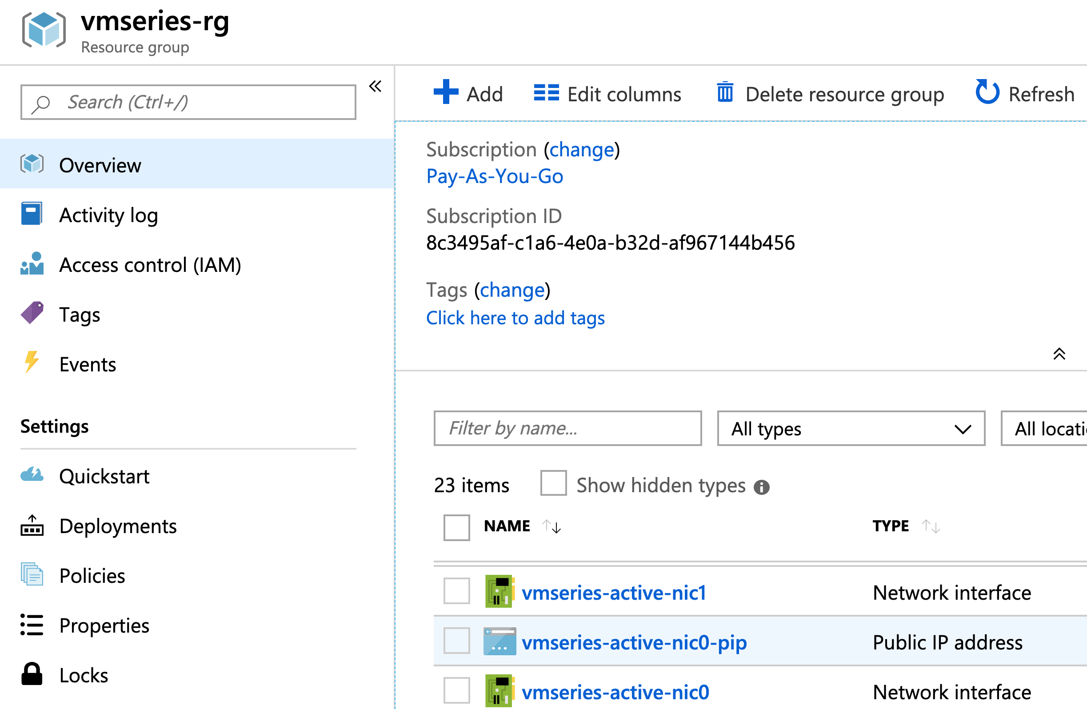
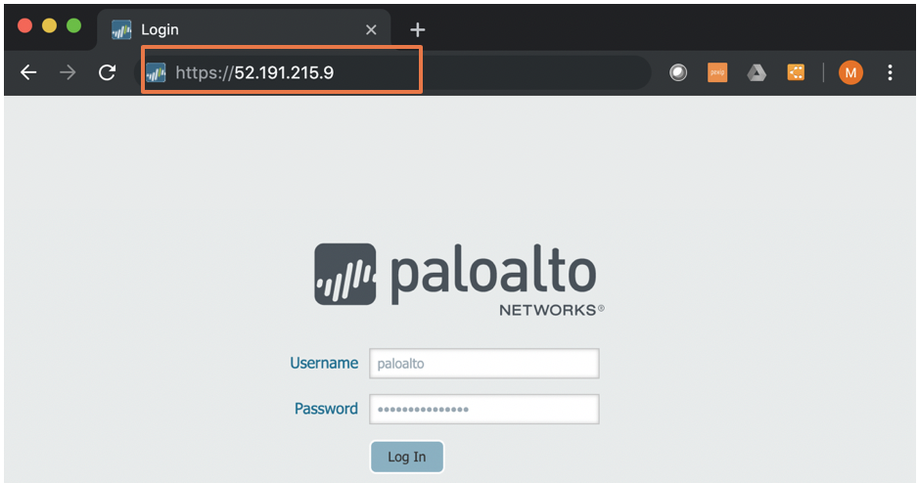
STEP 4. ACCESS ACTIVE FW GUI
2. Copy public IP Address
1. Resource Group → Overview → vmseries-active-nic0-pip
3. Paste into URL https://<public_ip>
Login with username & password from Step 2

Slide 9
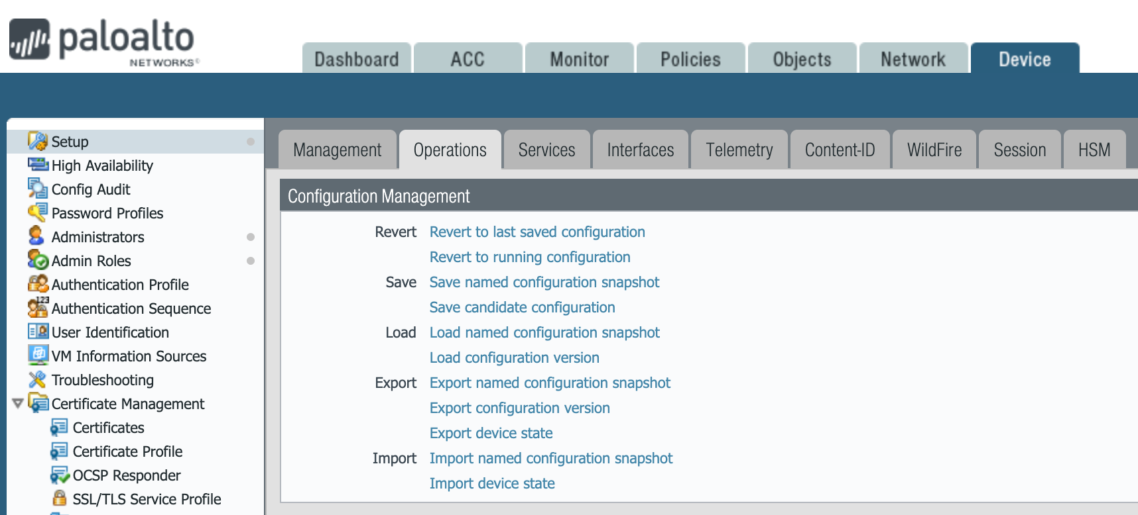
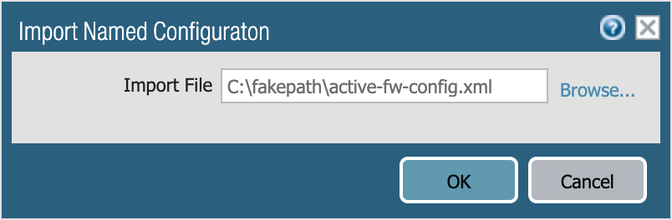
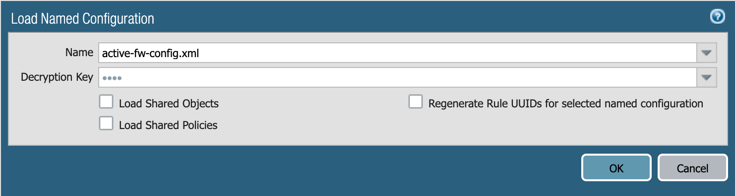
STEP 5. IMPORT & LOAD CONFIGURATION
Device → Setup → Operations
→ Import named configuration snapshot
→ select active-fw-config.xml
→ Load named configuration snapshot
→select active-fw-config.xml

Slide 10
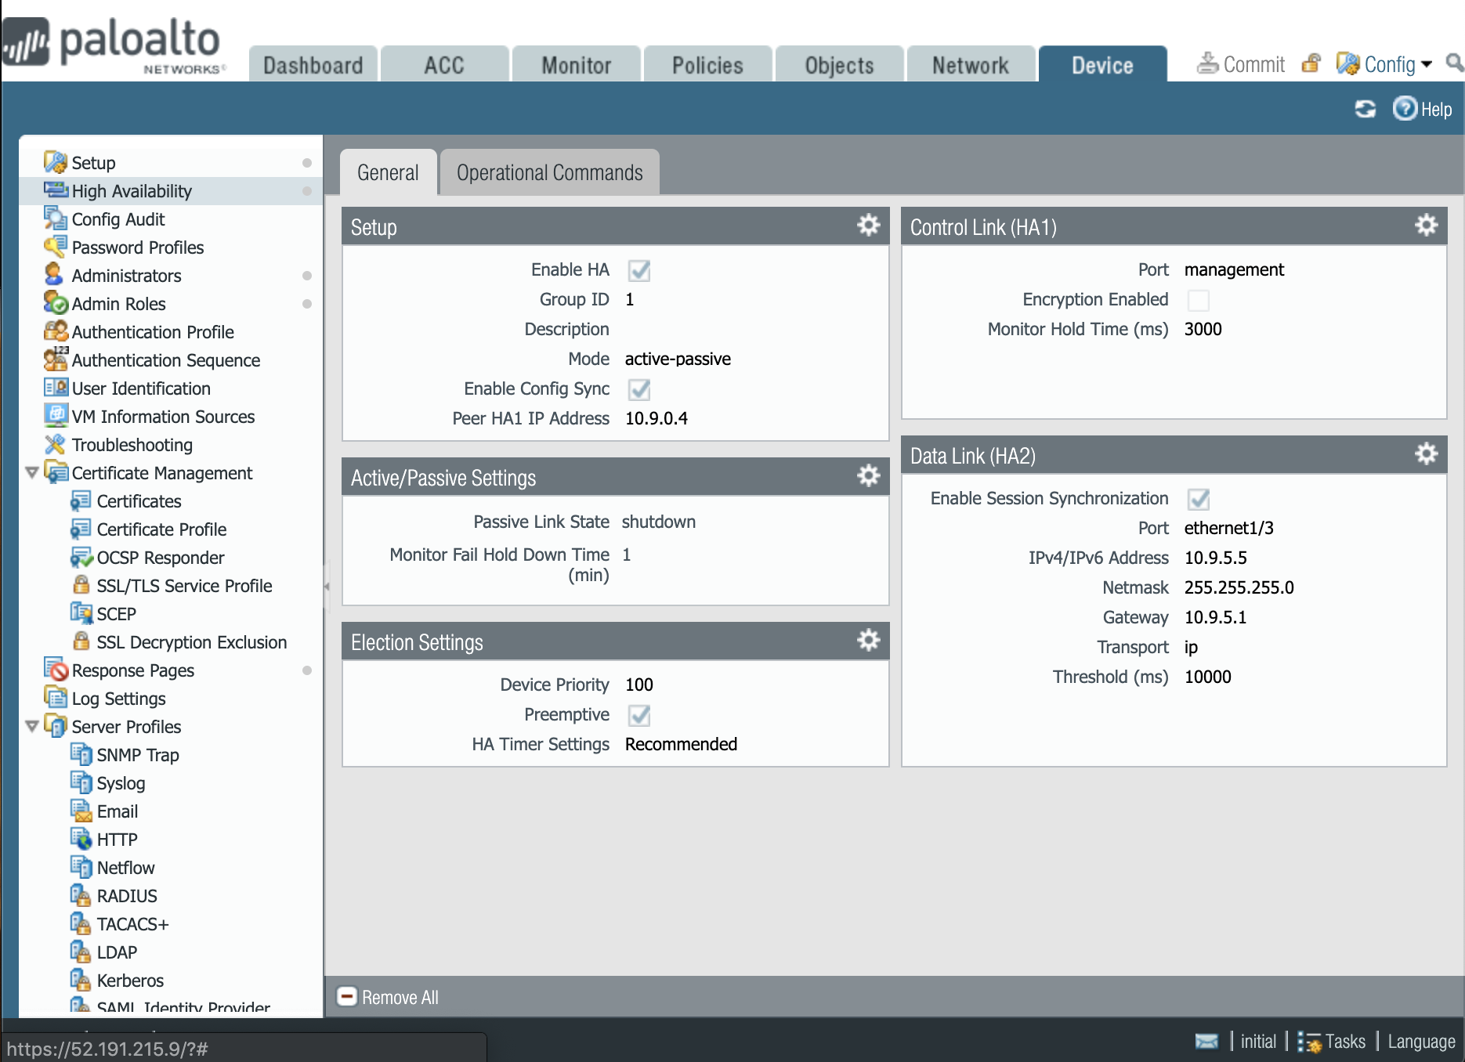
STEP 6. ENABLE HA
Device → High Availability
→ General→ Setup
→Check on Enable HA

Slide 11
CREATE AZURE SERVICE PRINCIPAL (skip if you already have one)
Please see: - Application and service principal objects in Azure Active Directory
- Create an Azure service principal with Azure CLI
Log into Azure CLI
> az login
Create service principal
> az ad sp create-for-rbac --name vmseries-HA
{
"appId": ”17c******-****-****-****-********061", ← Client ID
"displayName": "vmseries-HA",
"name": "http://vmseries-HA",
"password": ”*a36*****-****-****-****-********97b", ← Client Secret
"tenant": "52f*****-****-****-****-********b28" ← Tenant ID
}
Verify role
> az role assignment list --assignee 17c******-****-****-****-********061
[
{
"canDelegate": null,
"id": "/subscriptions/<subscription_id>/providers/Microsoft.Authorization/roleAssignments/<redacted>",
"name": "<redacted>",
"principalId": "<redacted>",
"principalName": "http://vmseries-HA",
"roleDefinitionId": "<redacted>",
"roleDefinitionName": "Contributor", ← Valid role
"scope": “<redacted>",
"type": "Microsoft.Authorization/roleAssignments"
}
]

Slide 12
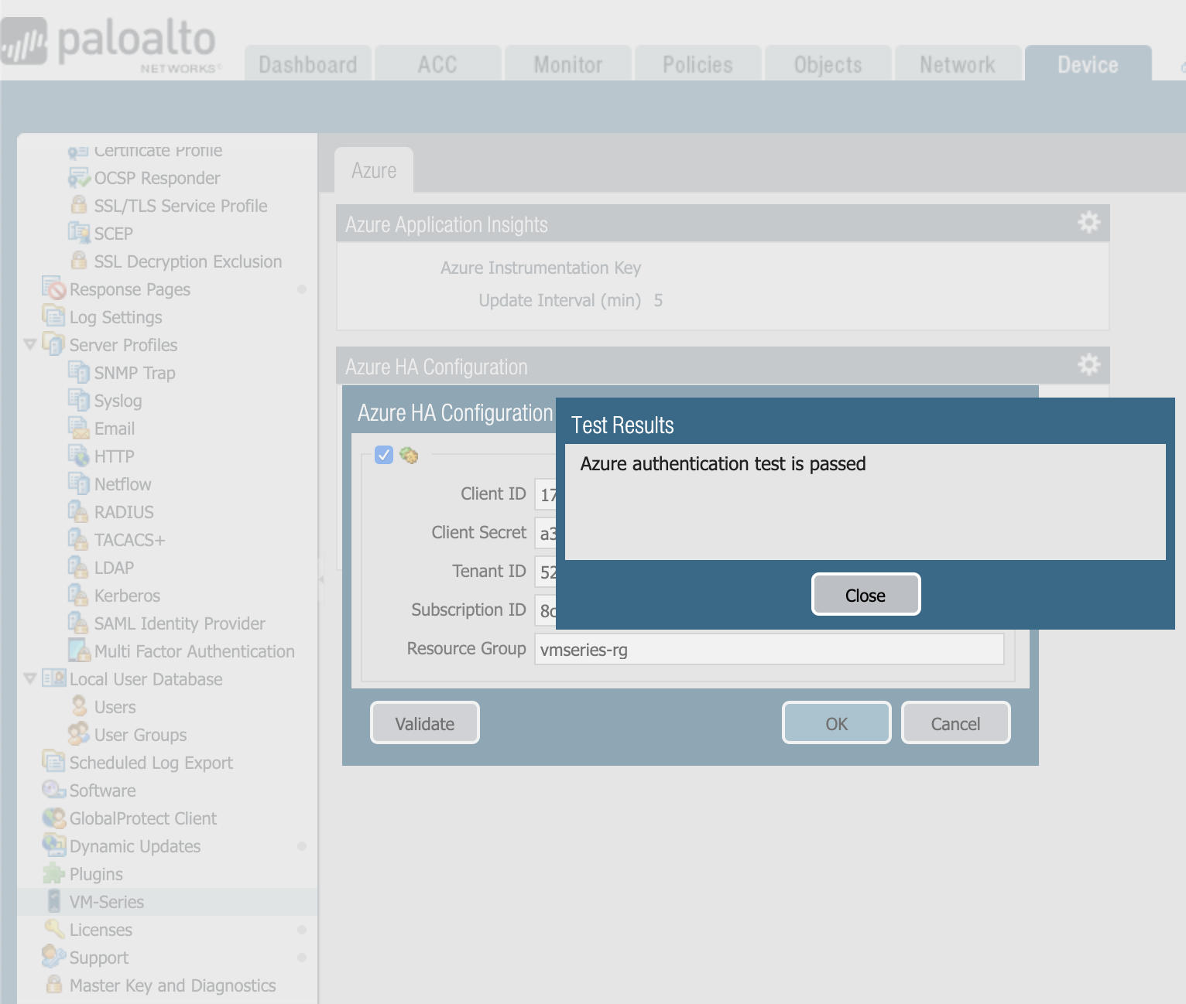
STEP 7. CONFIGURE AZURE HA PLUGIN
1. Device → VM-Series → Azure HA Configuration
→ Enter your Azure service principal parameters
2. Click Validate to test plugin authentication.
COMMIT CHANGES
The imported configuration has a default username & password
UN:paloalto / PW:PanPassword123!

Slide 13
CONFIGURE
PASSIVE FIREWALL

Slide 14
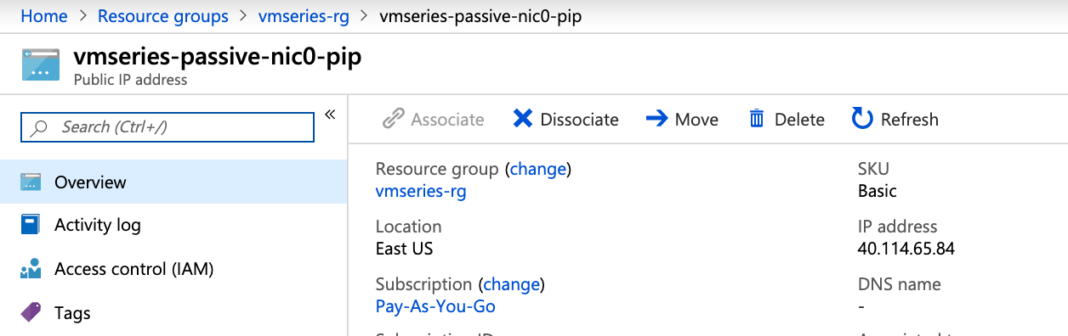
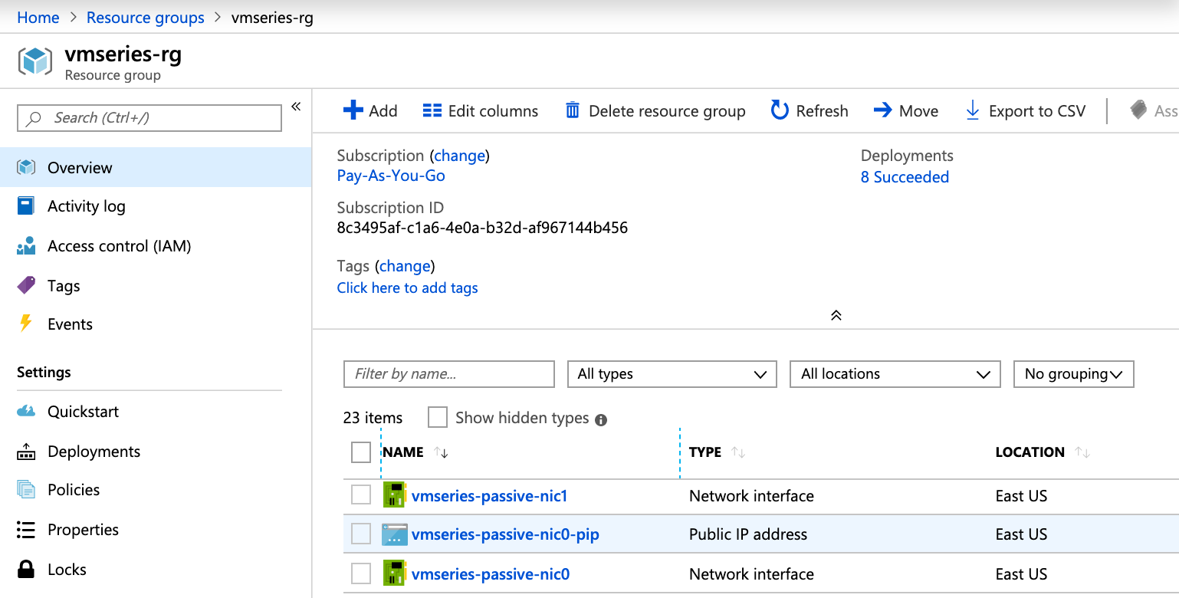
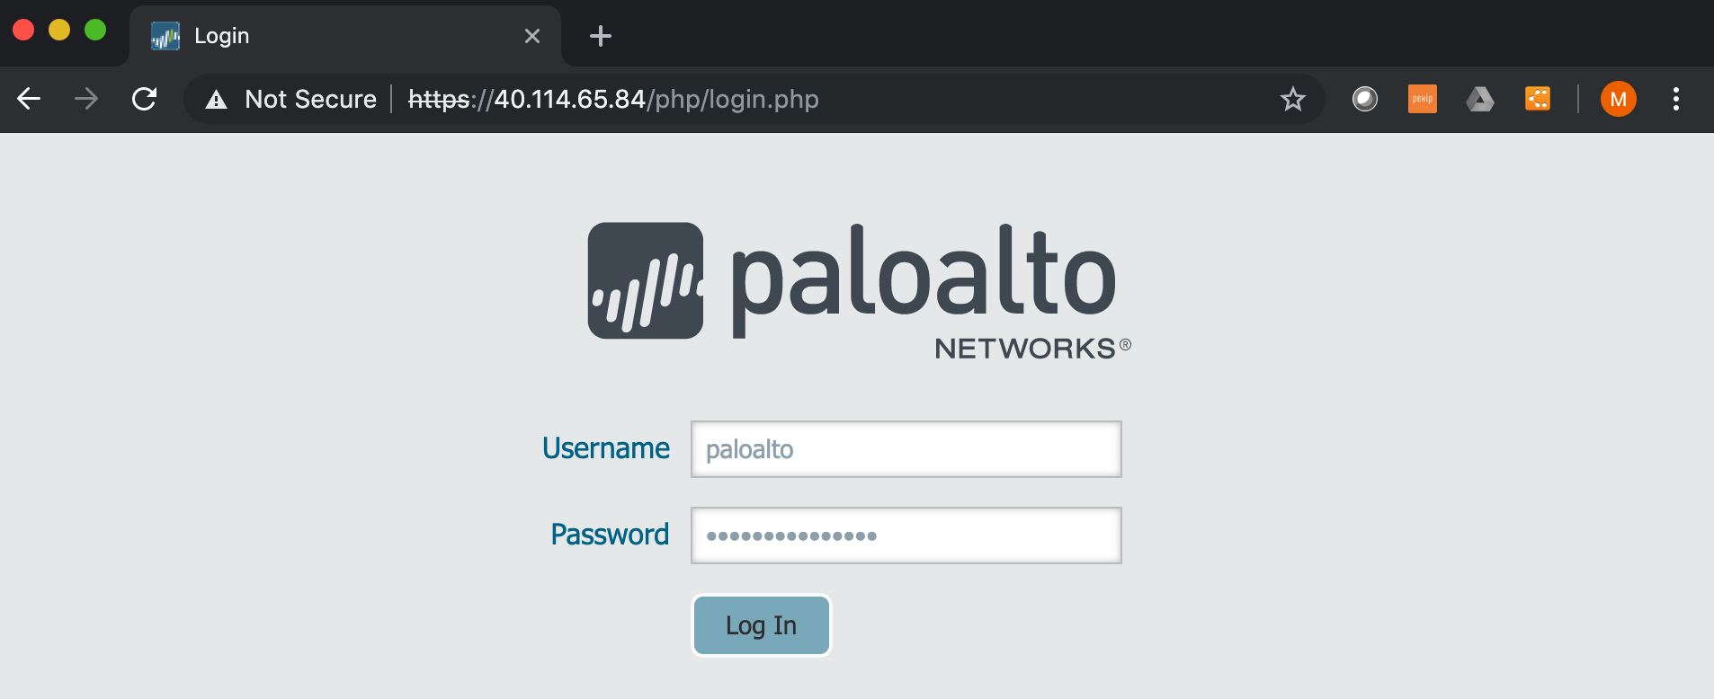
STEP 8. ACCESS PASSIVE FW GUI
2. Copy public IP Address
1. Overview → vmseries-passive-nic0-pip
3. Paste into URL https://<public_ip>
Login with username & password from Step 2

Slide 15
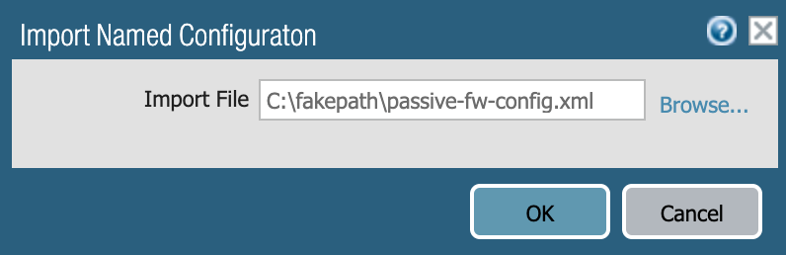
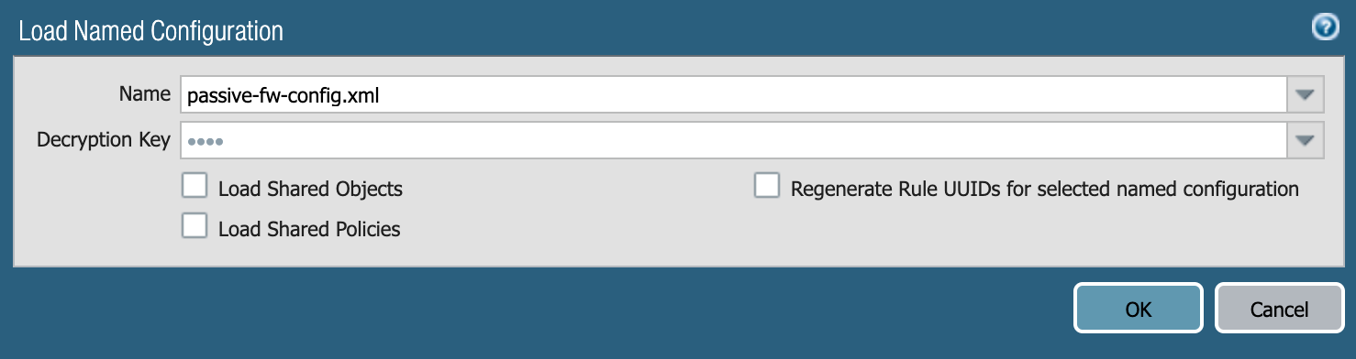
STEP 9. IMPORT & LOAD CONFIGURATION
Device → Setup → Operations
→ Import named configuration snapshot
→ select passive-fw-config.xml
→ Load named configuration snapshot
→select passive-fw-config.xml
COMMIT CHANGES
The imported configuration has a default username & password
UN:paloalto / PW:PanPassword123!

Slide 16
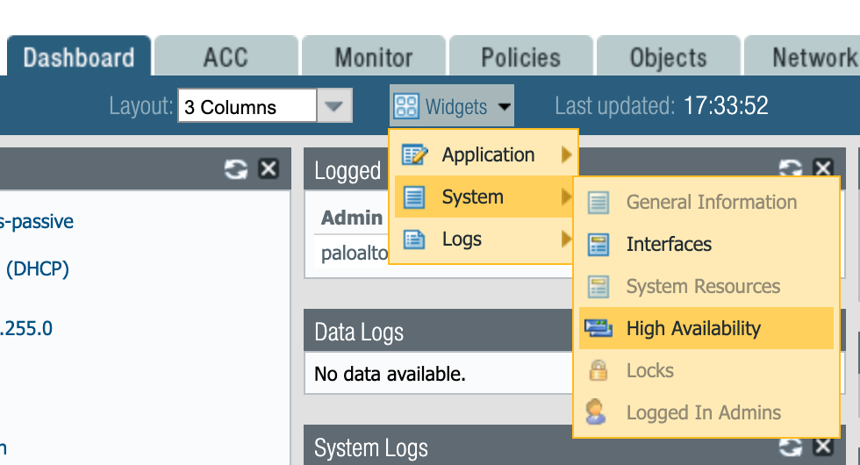
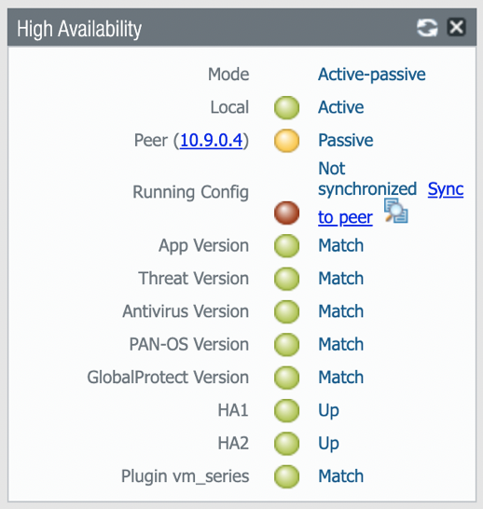
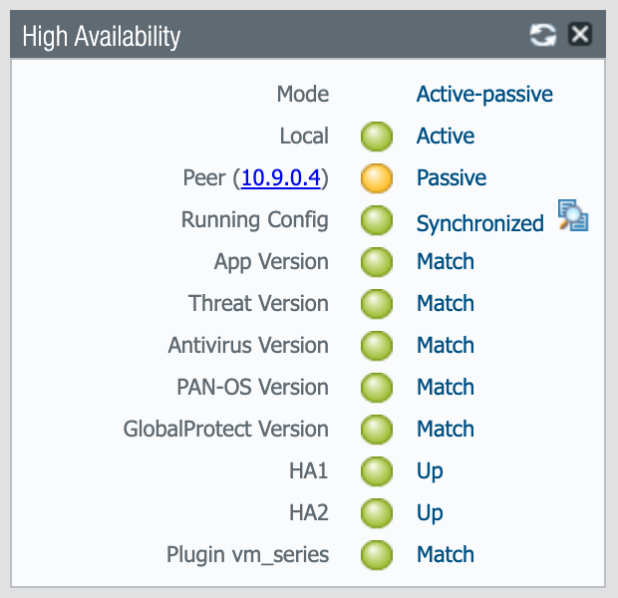
STEP 10. SYNC ACTIVE FW WITH PASSIVE FW
1. On both firewalls, enable the High Availability Widget
Dashboard → Widgets
→ System → High Availability
2. On the Active firewall, click Sync to peer.

Slide 17
TEST FAILOVER

Slide 18
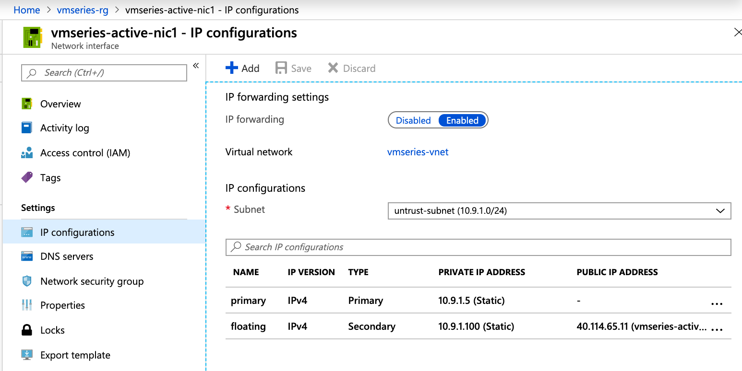
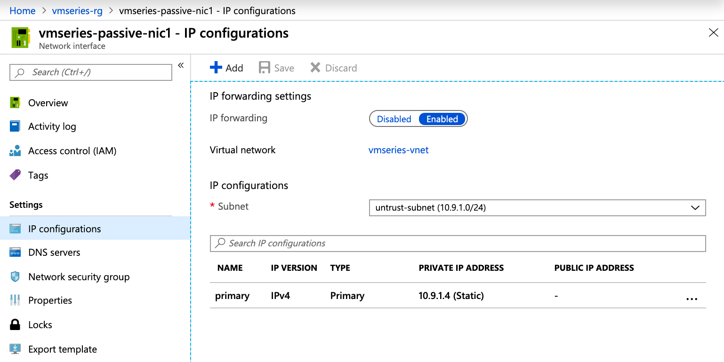
VERIFY UNTRUST FLOATING IP ON ACTIVE FW
1. In the Azure portal, open the IP configurations for vmseries-active-nic1 and vmseries-passive-nic1
2. The floating IP (10.9.1.100) resides on vmseries-active-nic1.
ACTIVE
(before failover)
PASSIVE
(before failover)

Slide 19
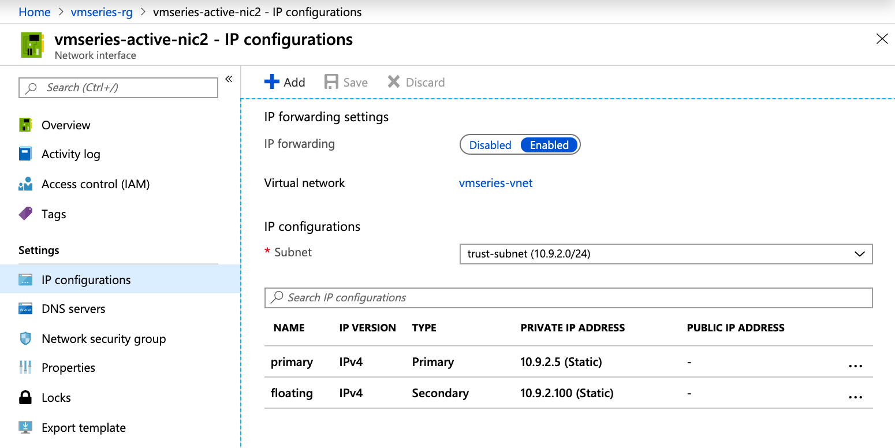

VERIFY TRUST FLOATING IP ON ACTIVE FW
1. In the Azure portal, open the IP configurations for vmseries-active-nic2 and vmseries-passive-nic2
2. The floating IP (10.9.2.100) resides on vmseries-active-nic2.
ACTIVE
(before failover)
PASSIVE
(before failover)

Slide 20
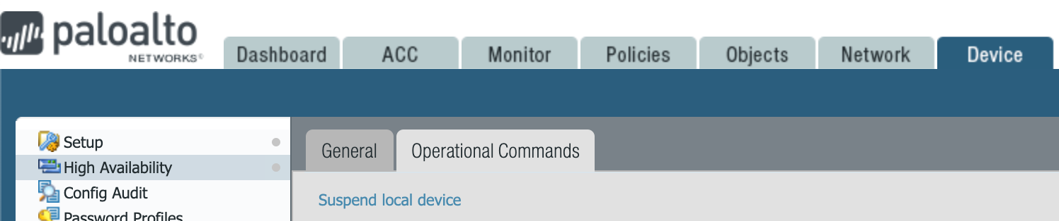
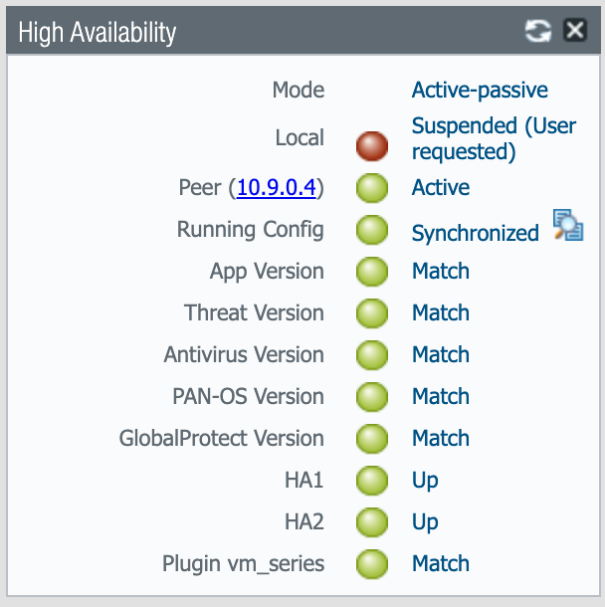
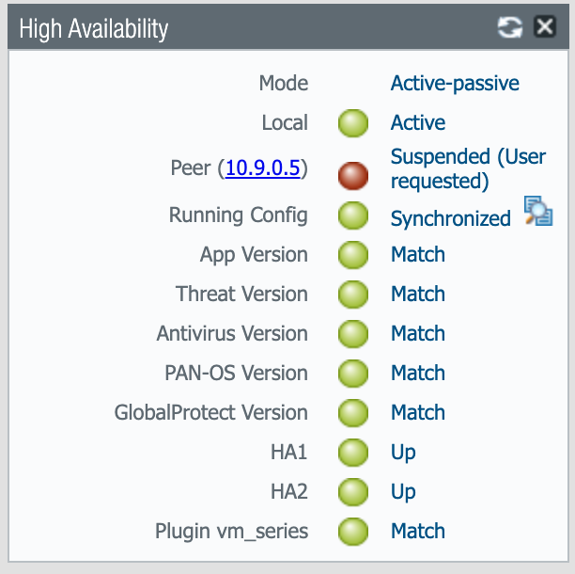
INITIATE A FAILOVER
1. On the Active firewall, go to:
Device → High Availability → Operational Commands
→ click Suspend local device
2. View the High Availability widget. The passive firewall
should now be Active.
ACTIVE
(after failover)
PASSIVE
(after failover)

Slide 21
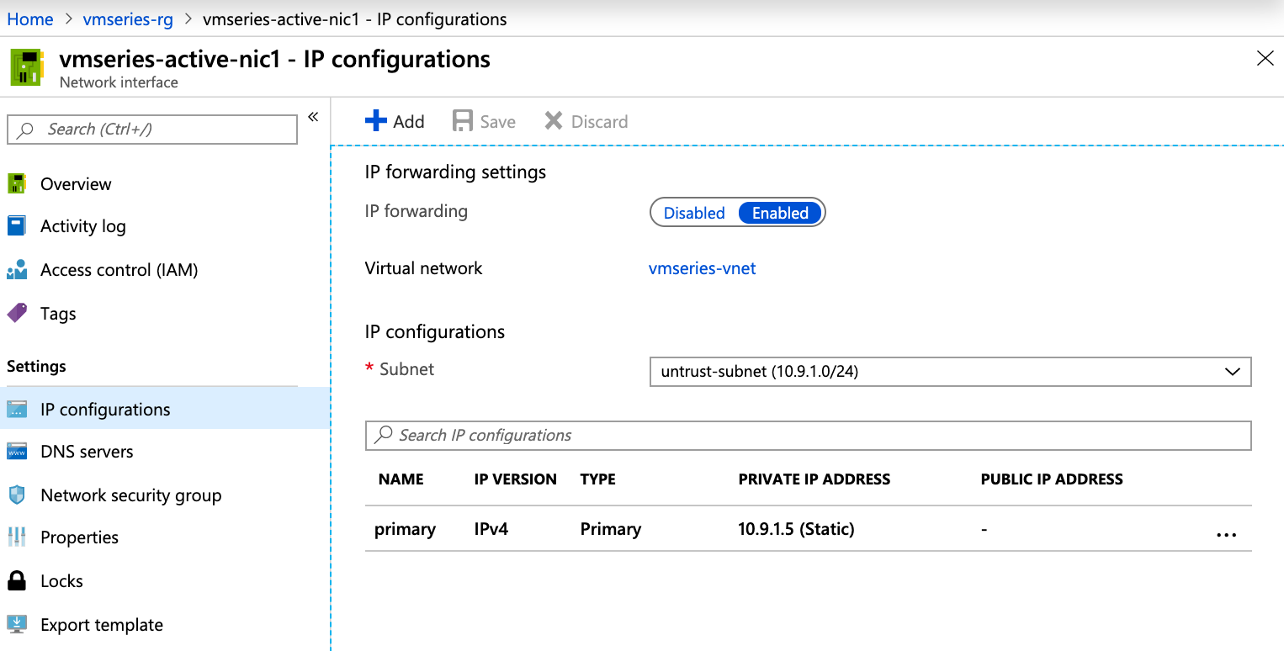
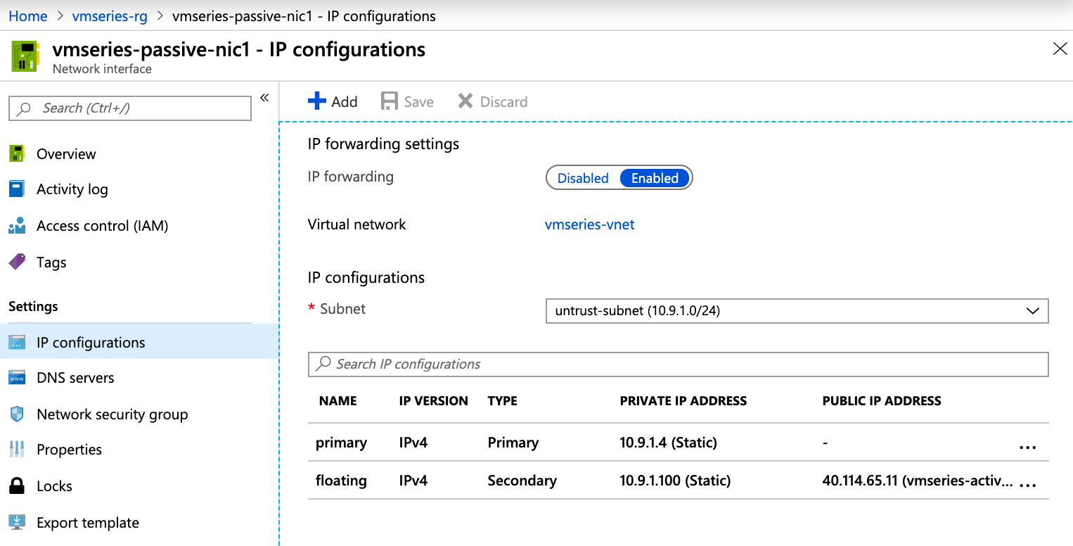
VERIFY UNTRUST FLOATING IP MOVE TO PASSIVE FW
1. In the Azure portal, open the IP configurations for vmseries-active-nic1 and vmseries-passive-nic1
2. The floating IP (10.9.1.100) should now belong to vmseries-passive-nic1
ACTIVE
(after failover)
PASSIVE
(after failover)

Slide 22
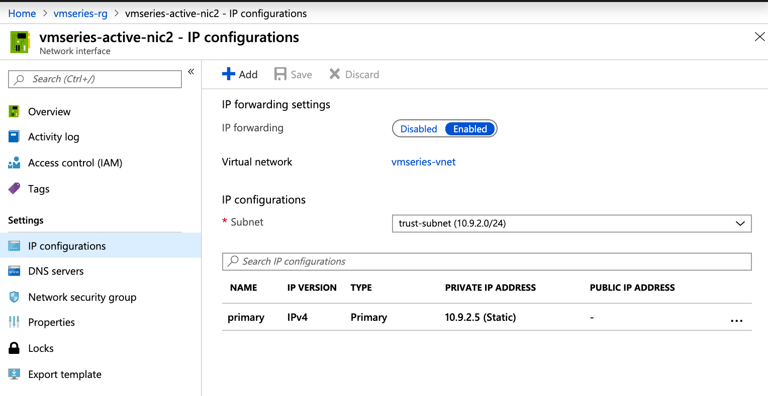
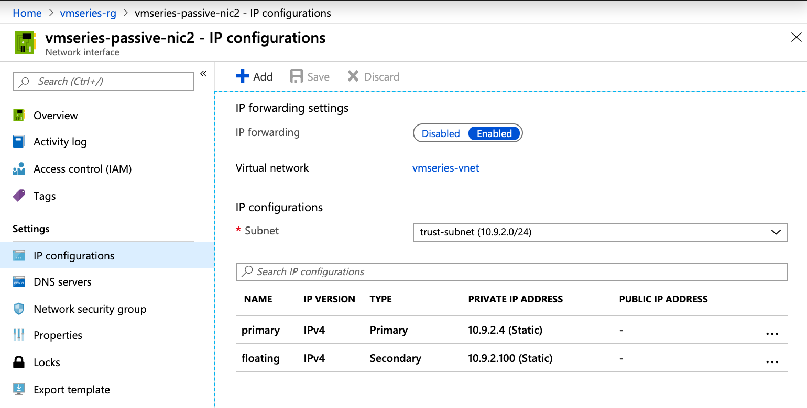
VERIFY TRUST FLOATING IP MOVE TO PASSIVE FW
1. In the Azure portal, open the IP configurations for vmseries-active-nic2 and vmseries-passive-nic2
2. The floating IP (10.9.2.100) should now belong to vmseries-passive-nic2
ACTIVE
(after failover)
PASSIVE
(after failover)

